Slide 1

Camera Pong
Virtual Ping Pong on an FPGA
Group 7
Jazim Akbar
Yogen
Henry Prickett-Morgan
Hao Yang

Slide 2
Project Description
Fully-in-hardware virtual ping pong game
Move in 2.5D
(left/right, up/down, and forward velocity)
Utilizes camera input to control the player paddle
Notes:
Henry

Slide 3
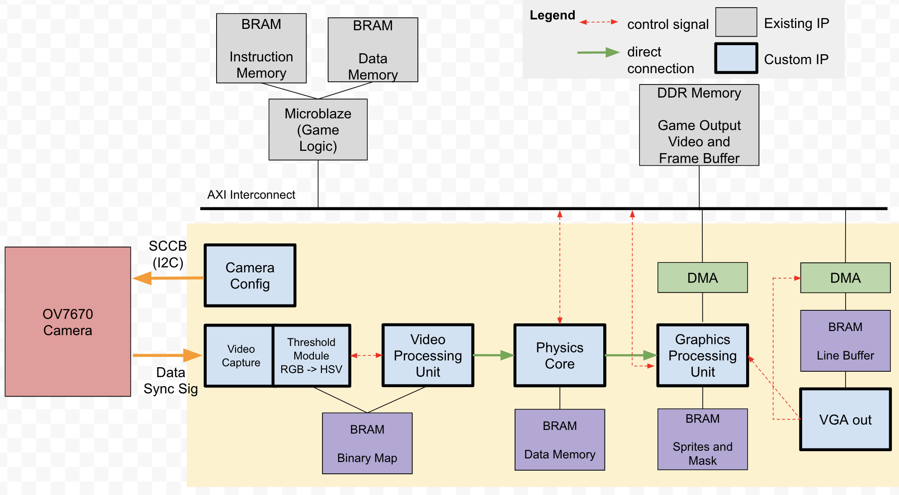
Previous Block Diagram
Notes:
Jazim

Slide 4
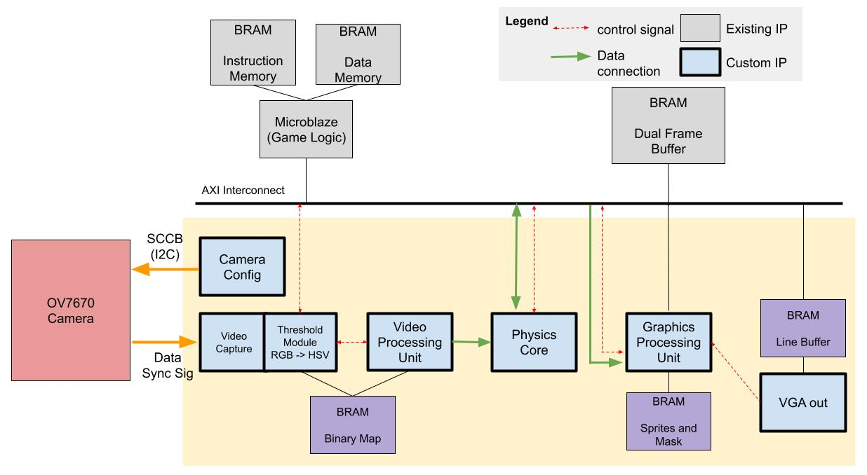
Current Block Diagram
Notes:
Jazim

Slide 5
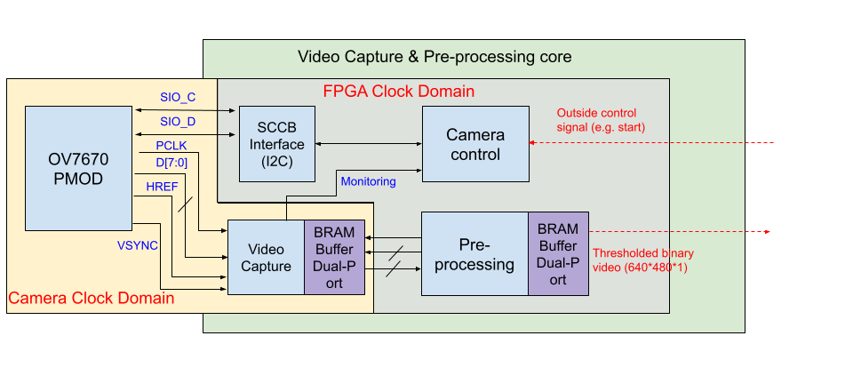
Camera Input & Pre-Processing – Previous
Notes:
Yogen

Slide 6
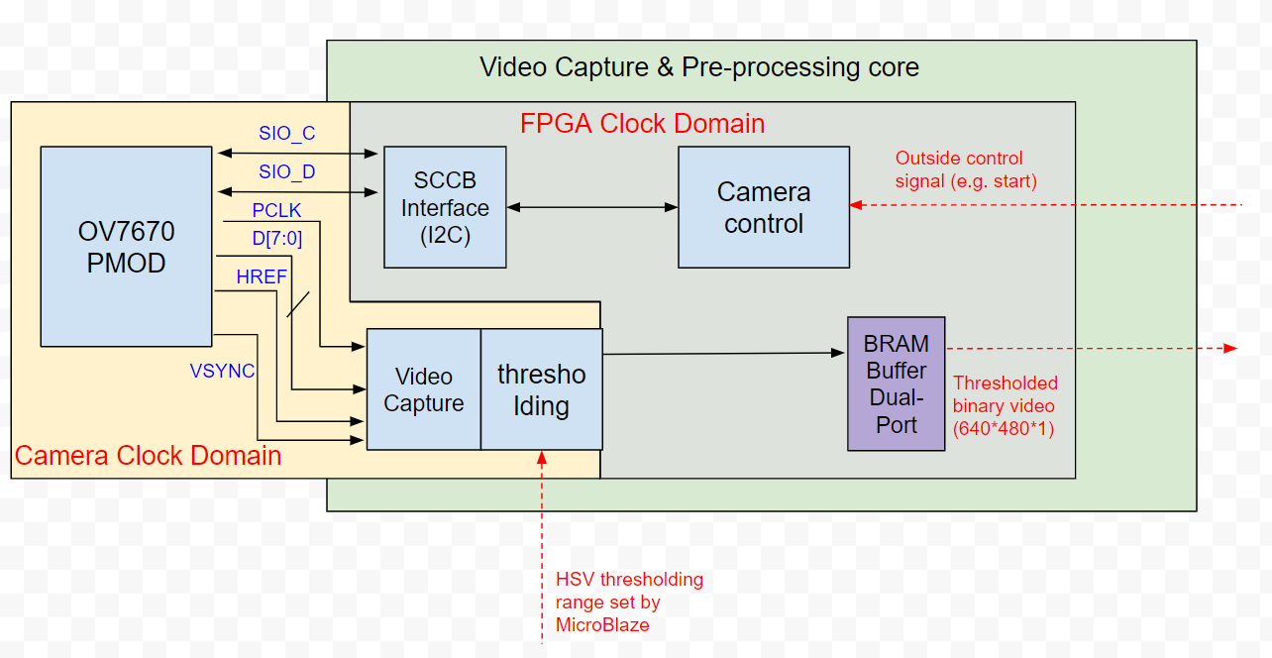
Camera Input & Pre-Processing – Current
Have a separate demo for it
Notes:
Yogen

Slide 7
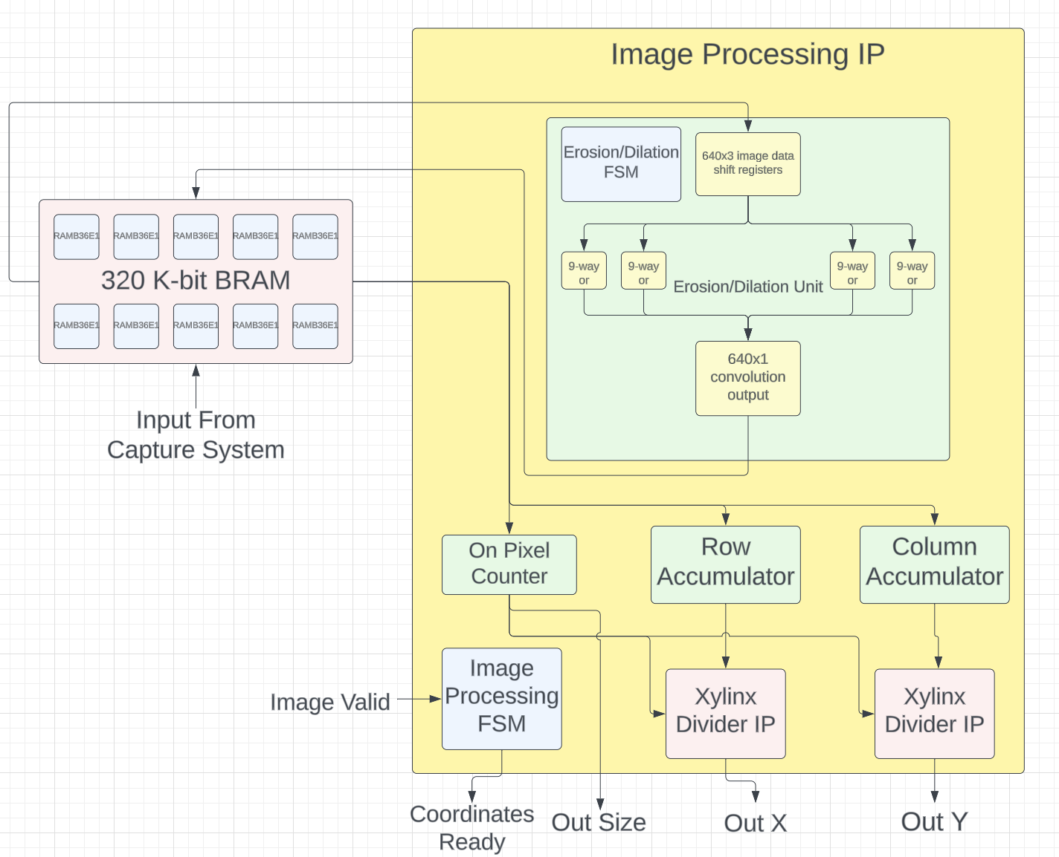
Image Processing
Notes:
Yogen

Slide 8
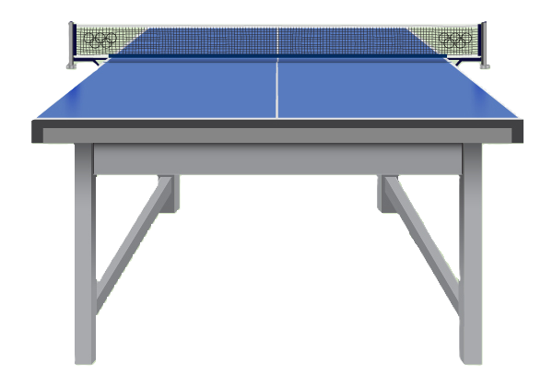
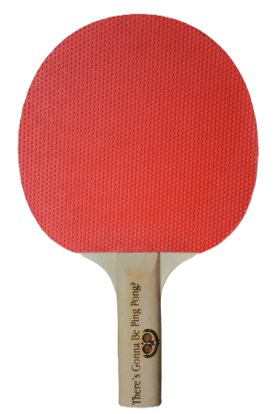

Physics
Update states based on velocity and acceleration
Detect object collisions
Handle new state after collision
Notes:
Henry

Slide 9
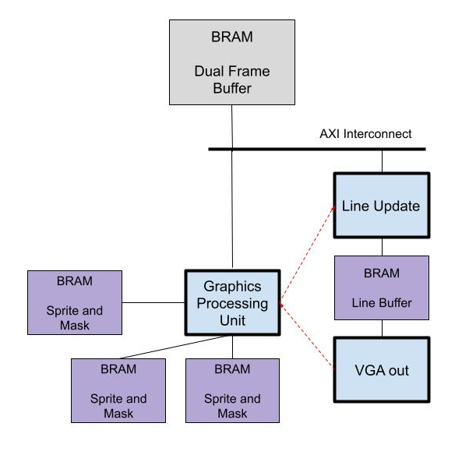
Graphics Rendering
Get position information of objects
Draw sprites based on position and scale in frame buffer
Mask unwanted pixels for more control
Notes:
Henry

Slide 10
Microblaze Orchestration
Microblaze exposes an interface to program the HSV threshold.
Microblaze in the rendering loop:
Poll results from physics IP
Calculate coordinate transforms from physics coordinate system to rendering coordinate system
Calculate the AI player movement
Write out where to render each sprite so rendering IP can construct the frame

Slide 11
Difficulty Score
Block | Complexity Points
VGA Camera PMOD | 1
HSV thresholding | 0.5
VGA Rendering and Output | 1.5
Convolutional Image Processing IP | 1
Physics IP | 0.5
Total | 4.5
Notes:
Henry

Slide 12
Improvements
Finish integration at the frontend/backend boundary.
Find better camera configuration settings so that the HSV thresholding can more accurately separate the intended target.
Implementation of more complex game logic.
Multiplayer between two networked boards.
Notes:
Henry

Slide 13
Thank You

